Slide 1
Software Engineering :
3 : Agile Methodologies
Professor Imed Bouchrika National School of Artificial Intelligence imed.bouchrika@ensia.edu.dz

Slide 2
Outline :
Agile Methodologies
Manifesto
Principles
eXtreme Programming
Scrum
Choosing a Process Model

Slide 3
Software Process Models: Agile Methodologies
What’s Agile
Agile processes are a family of software development methodologies that produce software in short iterations and allow for greater changes in design.
Although there is no absolute definition about what constitutes an Agile method, there are several characteristics shared by most Agile methods
The philosophy behind agile methods is reflected in the agile manifesto ( http://agilemanifesto.org) issued by the leading developers of these methods

Slide 4
Software Process Models: Agile Methodologies
Agile Manifesto:
We are uncovering better ways of developing software by doing it and helping others do it. Through this work we have come to value:
Individuals and interactions over processes and tools
Working software over comprehensive documentation
Customer collaboration over contract negotiation
Responding to change over following a plan
That is, while there is value in the items on the right, we value the items on the left more

Slide 5
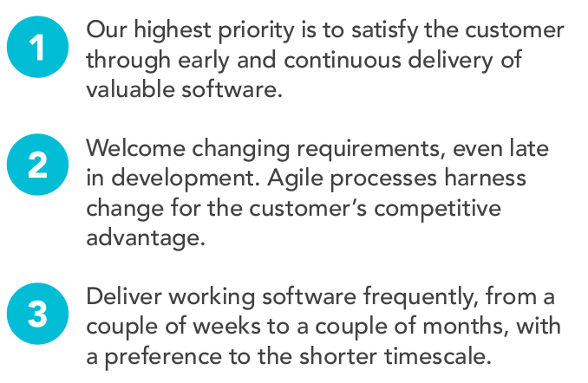
Software Process Models: Agile Methodologies
Agile Principles

Slide 6
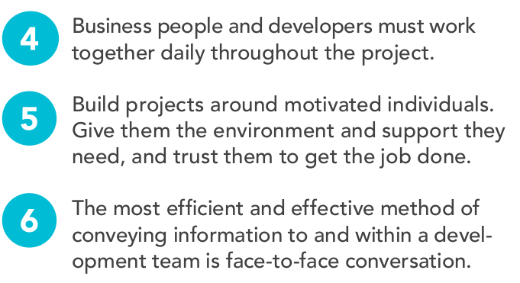
Software Process Models: Agile Methodologies
Agile Principles

Slide 7
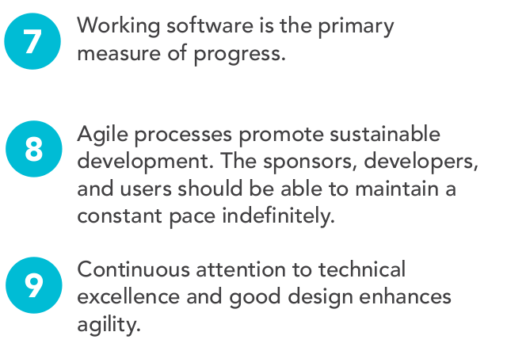
Software Process Models: Agile Methodologies
Agile Principles

Slide 8
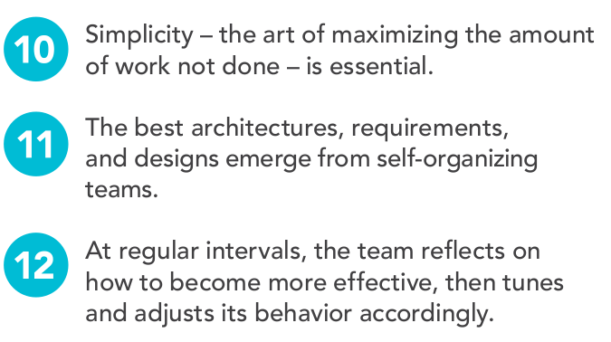
Software Process Models: Agile Methodologies
Agile Principles

Slide 9
Software Process Models: Agile Methodologies
Agile Principles Rephrased and Explained
01
Short releases and iterations :
Divide the work into small pieces.
Release the software to the customer as often as possible.
Every release/sprint should have a set newer functionalities/bug fixes based on their priorities

Slide 10
Software Process Models: Agile Methodologies
Agile Principles Rephrased and Explained
02
Incremental design:
Don’t try to complete the design up front because not enough is known early about the system.
Delay design decisions as much as possible, and improve the existing design when more knowledge is acquired.

Slide 11
Software Process Models: Agile Methodologies
Agile Principles Rephrased and Explained
03
User involvement :
Rather than trying to produce formal, complete, immutable standards at the beginning,
Ask the users involved with the project to provide constant feedback.
Customers should be closely involved throughout the development process.

Slide 12
Software Process Models: Agile Methodologies
Agile Principles Rephrased and Explained
04
Embrace change
Expect the system requirements to change, and so design the system to accommodate these changes.

Slide 13
Software Process Models: Agile Methodologies
Agile Principles Rephrased and Explained
05
People, not process :
The skills of the development team should be recognized and exploited.
Team members should be left to develop their own ways of working without prescriptive processes.

Slide 14
Software Process Models: Agile Methodologies
Agile Principles Rephrased and Explained
06
Maintain simplicity
Focus on simplicity in both the software being developed and in the development process including the communication activity
Actively work to eliminate complexity from the system.

Slide 15
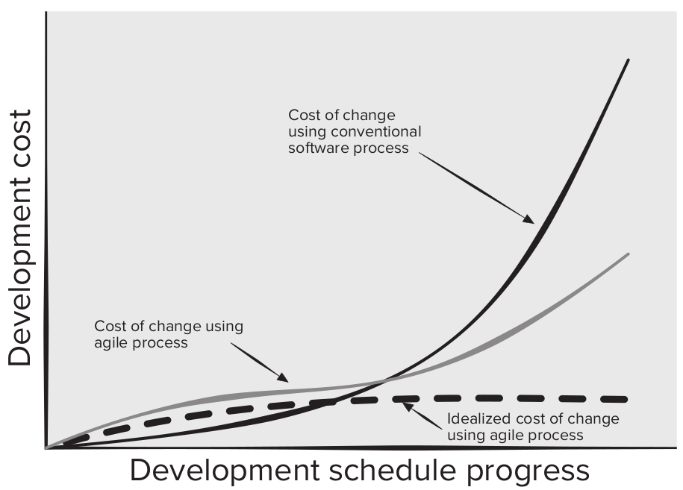
Software Process Models: Agile Methodologies
Agile Processes vs Traditional Processes when it comes to Handling Changes

Slide 16
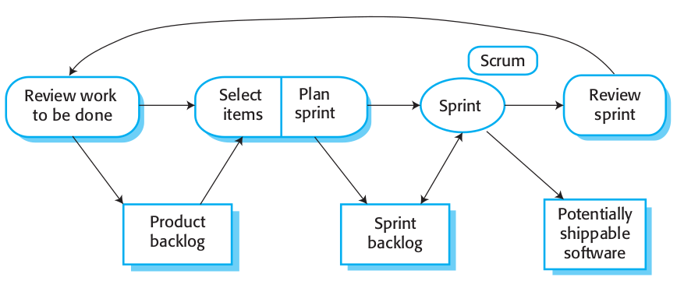
Scrum Principles for Software Projects
Scrum Process Model

Slide 17
Scrum Principles for Software Projects
Scrum : Definition
Is a project management framework or even a methodology composed of a set of principles for creating, improving and delivering high-quality products to customers in an iterative and incremental way.
It emphasizes on teamwork, collaboration, communication, transparency and continual improvement among team members ⇒ ( Self-organized Teams )
Scrum is built upon by the collective intelligence of the people using it. Rather than provide people with detailed instructions, the rules of Scrum guide the relationships and interactions

Slide 18
Scrum Principles for Software Projects
Scrum : Why ?
It is designed to deliver value to the customer and satisfy their needs throughout the development of the project by:
Selecting and prioritizing the right functionalities at the right increment of delivery
Creating an environment featured by transparency in communication, collective responsibility and continuous progress

Slide 19
Scrum Principles for Software Projects
Scrum : Why ?
The product is broken down into a set of manageable and understandable chunks/deliverables
Unstable requirements do not hold up progress. ( Complex features, can wait, whilst we can deliver incrementally new features)
Customers see on-time delivery of increments and gain feedback on how the product works
The whole team has visibility of everything, and consequently team communication and morale are improved

Slide 20
Scrum Principles for Software Projects
Scrum : Why ?
The product is broken down into a set of manageable and understandable chunks/deliverables
Unstable requirements do not hold up progress. ( Complex features, can wait, whilst we can deliver incrementally new features)
Customers see on-time delivery of increments and gain feedback on how the product works
The whole team has visibility of everything, and consequently team communication and morale are improved
More suited to the current trends of applications in this era Startup Apps, Mobile Apps… are mostly needed in a short time of few months (not years)

Slide 21
Scrum Principles for Software Projects
Scrum : History
The use of Scrum dates back to 1986 inside the article “The new product development game” published by Hirotaka Takeuchi & Ikujiro Nonaka in Harvard Business Review. The article describes
How big companies ( Canon, Honda ..) produce new products using a scalable and team-based approach whilst focusing on principles of self-organized teams.
In 1993, Jeff Sutherland and his team created the Scrum Process for the development of of software products at Easel Corporation.

Slide 22

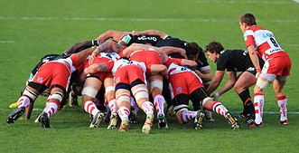
Scrum Principles for Software Projects
Scrum : Term
Waterfall Model Analogy to the Relay race
Each athlete (racer) will do his phase/lap.
In the next phase, they will pass the baton (stick) to the next racer
Scrum as a word is drawn from the Rugby game indicating Restarting a play/game after stoppage due to a foul or …
Analogy for Software Development, The developers work as a team during each iteration, afterwards, all members restart fresh from the same point.

Slide 23
Scrum Principles for Software Projects
Scrum members :
Committed ( Scrum Team)
are members who are fully committed to the success of the project.
Smaller teams of 10 members or less to avoid gaps in communication and decreased productivity.
Is Accountable for creating a valuable increment at every sprint.
Involved
This includes members who have interest in the success of the project including executives, customers…

Slide 24
Scrum Principles for Software Projects
Scrum Roles for Committed members (Scrum Team):
Product Owner
Scrum Master
Development Team

Slide 25
Scrum Principles for Software Projects
Scrum Roles :
Product Owner [ Must be Single Person, not committee of people]
Responsible for setting the vision of the product and its primary goal.
Communicate with the clients, end-users and stakeholders to understand their needs and get feedback from them.
Have an insight on how to increase the value of the product
Is accountable for managing the product backlog
Creating, Ordering and Communicating product backlog items
Ensuring that the product backlog is transparent, visible and understood.
Approves the delivered product sprint by validating it is meeting the intended value.

Slide 26
Scrum Principles for Software Projects
Scrum Roles :
Scrum Master ( Servant Leadership )
He/She is the facilitator of the team ensuring that :
Smooth communication between the product owner the development team
Team is progressing on time and meeting deadlines to deliver an increment of the product and remove any obstacle hindering the progress.
Team is following the scrum methodology throughout the entire process :
Train, teach , lead daily meetings and provide feedback

Slide 27
Scrum Principles for Software Projects
Scrum Roles :
Development Team
They execute the sprint under the vision of the product owner and the direction of the scrum master.
Consists of cross-functional members ( with specialized skills ) with the responsibility to turn the Product Backlog items they select into an Increment of useful and valuable product functionality
They are responsible for managing the progress of work during a Sprint
Cross-functional : members from different areas/departments

Slide 28
Scrum Principles for Software Projects
Scrum Artifacts :
Product Backlog
Spring Backlog
Product Increment

Slide 29
Scrum Principles for Software Projects
Scrum Artifacts :
Product Backlog :
List of all features, functions, requirements, enhancements, and fixes to be made to the product in future releases.
Product Backlog items :
Have the attributes of a description, order, estimate duration and value.
Include test descriptions that will prove its completeness when "Done".
Product Backlog refinement is the act of breaking down and further defining Product Backlog items into smaller more precise items
Maintained and managed by the Product Owner.

Slide 30
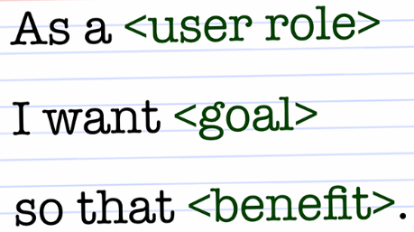
Scrum Principles for Software Projects
Scrum Artifacts :
Product Backlog :
Items are usually inserted in the form of
User Story : is an informal statement to express a small feature from the perspective of an end-user whilst clearly showing the value.
As a (Website Visitor), I want to (login) , so that I can (access my expenses)
As a (Website Visitor), I want to (reset password) , so that I can (regain access to my account)
Action Task : Corresponding to an action item to be executed.
Implement UI for login with minimal design.
Implement BL to verify authentication against internal DB
Epic : Set of stories that would correspond to a major feature/component to be implemented.
Internal Dashboard to add expenses.

Slide 31
Scrum Principles for Software Projects
Scrum Artifacts :
Sprint Backlog :
Is composed of Spring Goal + a list of all the work items (usually TASKS) that must be done by the end of the sprint timebox
Timebox : is the time frame/duration that should not be exceeded to complete a task/sprint/meeting … A sprint timebox is ranging from 2 weeks to 4 weeks..
Tasks are taken from the product backlog, prioritized and assigned to members of the development team during the sprint meeting.
Depending on the state of the project, tasks may be added to, removed from, or re-prioritized in the sprint backlog

Slide 32
Scrum Principles for Software Projects
Scrum Artifacts :
Product Increment :
is the set of all the tasks, use cases, user stories, product backlogs and any element that :
is developed during the sprint(s)
is marked as completed based on the “done definition”
will be made available to the end user in the form of Software.
Product increments should build upon each other until the team completes the project.

Slide 33
Scrum Principles for Software Projects
Scrum Ceremonies ( Events ) :
Are meetings or events to inspect and adapt Scrum artifacts with the aim to improve transparency.
To reduce complexity, Scrum events are held at the same time and same place.
List of Scrum Events
Sprint Planning
Daily Scrum
Sprint Review
Sprint Retrospective

Slide 34
Scrum Principles for Software Projects
Scrum Ceremonies :
Are meetings or events to inspect and adapt Scrum artifacts with the aim to improve transparency.
To reduce complexity, Scrum events are held at the same time and same place.
List of Scrum Events
Sprint Planning
Daily Scrum
Sprint Review
Sprint Retrospective
Take place at the start of the Sprint, Its aim is to select items from the Product Backlog to be implemented in the current Sprint.
Attended by all members and chaired by the PO to discuss the most important items .
Three Points in this event: - Why is this Sprint Valuable ? - What can be done in this Sprint ? - How will the chosen work get done ?

Slide 35
Scrum Principles for Software Projects
Scrum Ceremonies :
Are meetings or events to inspect and adapt Scrum artifacts with the aim to improve transparency.
To reduce complexity, Scrum events are held at the same time and same place.
List of Scrum Events
Sprint Planning
Daily Scrum
Sprint Review
Sprint Retrospective
Daily brief meetings of 15 minutes timebox for developers ( no need for PO and SM to attend, unless they are developers too). The aim is for every member to stand up and speak about : - What did I do yesterday? - What will I do today? - Are there any impediments in my way?

Slide 36
Scrum Principles for Software Projects
is to inspect the outcome of the Sprint and determine future adaptations
The Scrum Team presents the results of their work to key stakeholders and progress toward the Product Goal is discussed.
Attendees collaborate on what to do next. The Product Backlog may also be adjusted to meet new opportunities
The event is timeboxed to a maximum of four hours for a one-month Sprint
Scrum Ceremonies :
Are meetings or events to inspect and adapt Scrum artifacts with the aim to improve transparency.
To reduce complexity, Scrum events are held at the same time and same place.
List of Scrum Events
Sprint Planning
Daily Scrum
Sprint Review
Sprint Retrospective

Slide 37
Scrum Principles for Software Projects
Scrum Ceremonies :
Are meetings or events to inspect and adapt Scrum artifacts with the aim to improve transparency.
To reduce complexity, Scrum events are held at the same time and same place.
List of Scrum Events
Sprint Planning
Daily Scrum
Sprint Review
Sprint Retrospective
The aim of the Sprint Retrospective is to plan ways to increase quality and effectiveness.
The Scrum Team inspects how the last Sprint went with regards to individuals, interactions, processes, tools, and their Definition of Done.
It is timeboxed to a maximum of three hours for a one-month Sprint.

Slide 38
Scrum Principles for Software Projects
Scrum Burndown Chart :
Items are assigned an estimated duration in terms of hours. (Or even points reflecting the complexity of the task.)
At each sprint :
At day n
We compute the number of estimated hours left.
Whenever developers work on an item, they update the progress ( estimated hours left)

Slide 39
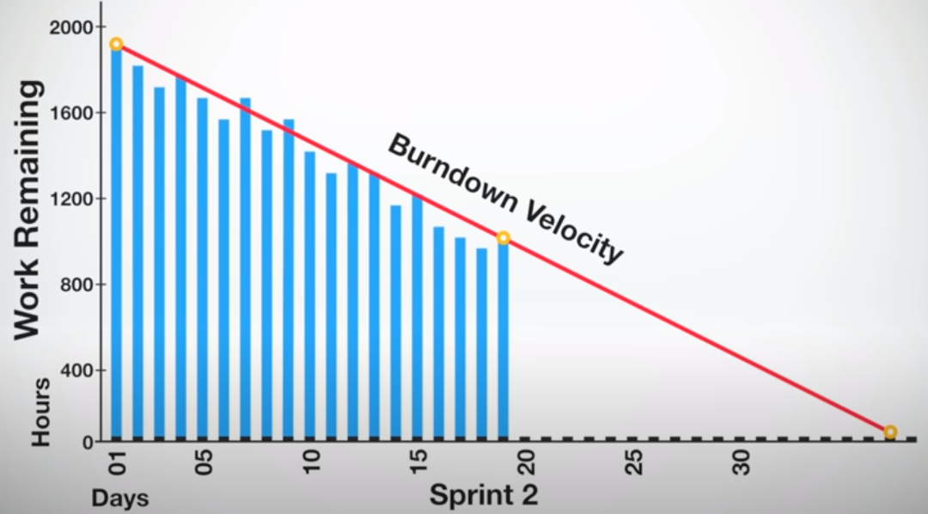
Scrum Principles for Software Projects
Scrum Burndown Chart : Can be used to predict if a sprint can be completed on time by computing the Burndown Velocity

Slide 40
Scrum Principles for Software Projects
Five Values of Scrum :
Commitment : Members commits to achieving its goals and to supporting each other.
Focus : Their primary focus is on the work of the Sprint to make the best possible progress toward these goals
Openness : The Scrum Team and its stakeholders are open about the work and the challenges ( they share progress, information…)
Respect : Scrum Team members respect each other to be capable, independent people, and are respected as such by the people with whom they work
Courage : The Scrum Team members have the courage to do the right thing, to work on tough and challenging problems.

Slide 41
Scrum Principles for Software Projects
Steps of How to get started using Scrum :
Setup the tools/platform for using Scrum ( Jira/Google Calendar/Slack / .. )
As a team, Assign
A member as the Product owner for the project ( Someone who is the visionary of the project)
A member as Scrum Master ( Someone with better skills in leading, management and knowledgeable ).
Rest of the team, are the development team ( including even the PO + SM)
Product owner will be gathering the requirements and turning them into tasks/stories inside the product backlog
The scrum master needs to define and fix the timing for the ceremonies
Sprint Planning : 1st Monday or Tuesday or .. of every month. / or every two weeks
Daily Scrum : every day at 9AM.
Sprint Review : last thursday of the 4rd week ? or ….
Sprint Retrospective : A day before the Sprint Planning

Slide 42
Scrum Principles for Software Projects
Steps of How to get started using Scrum :
Iteratively:
Hold the Sprint Planning Meeting :
Discuss the items to execute in the sprint,
Assign them to developes
Sprint Execution :
Daily Scrum Meeting
Development
Integration
Testing
Acceptance based on Done Definition
Sprint Review
Sprint Retrospective Meeting.

Slide 43
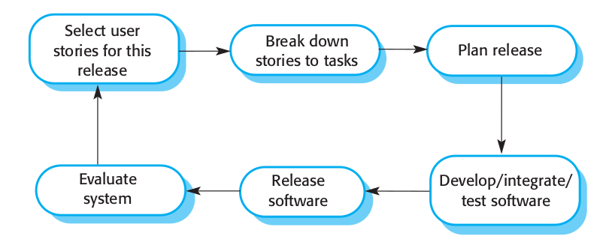
eXtreme Programming (XP)
XP Process Model

Slide 44
eXtreme Programming (XP)
XP Process Model
XP is an acronym for eXtreme Programming
The most widely used agile process
This approach uses user stories or scenarios for requirements, test-driven development, has direct customer involvement on the team (typically defining acceptance tests), uses pair programming, and provides for continuous code refactoring and integration.

Slide 45
eXtreme Programming (XP)
XP Process Model
Why Pair Programming:
It supports the idea of collective ownership and responsibility for the system
It acts as an informal review process because each line of code is looked at by at least two people
It encourages refactoring to improve the software structure, readability of source code and even maintainability

Slide 46
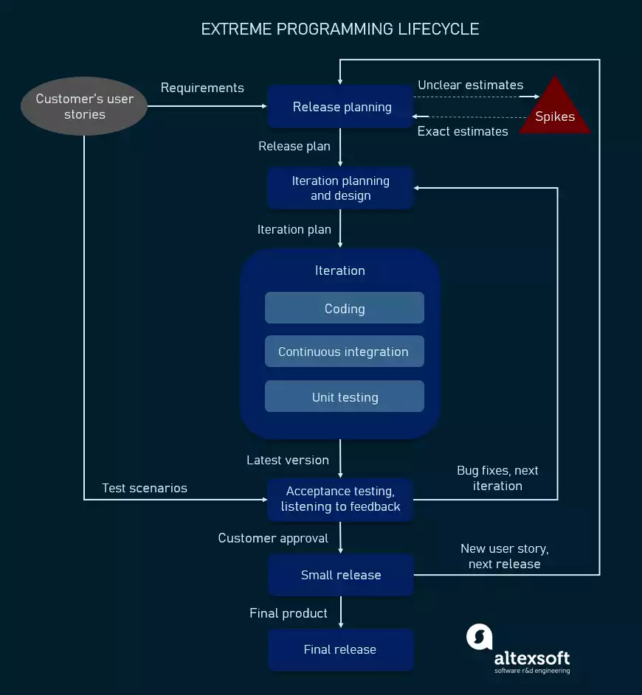
eXtreme Programming (XP)
XP Life Cycle
Image copied from https://content.altexsoft.com/
Image copied from https://content.altexsoft.com/

Slide 47
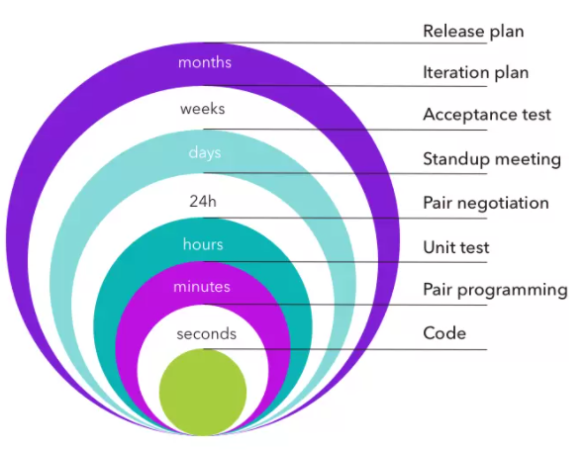
eXtreme Programming (XP)
XP Life Cycle
Timing for each phase/activity
Image copied from https://content.altexsoft.com/

Slide 48
eXtreme Programming (XP)
eXtreme Programming (XP) Principles:
Code Standard
Refactoring
Pair Programming
Test-Driven Development
Collective Code Ownership
Continuous Integration
Small Release
Onsite Customer
Sustainable Pace
System Metaphor
Simple Design
Planning Game

Slide 49
eXtreme Programming (XP)
eXtreme Programming (XP) Principles:
Code Standard
Refactoring
Pair Programming
Test-Driven Development
Collective Code Ownership
Continuous Integration
Small Release
Onsite Customer
Sustainable Pace
System Metaphor
Simple Design
Planning Game
Coding Standards : conventional recommendations of the coding style to ensure consistency, readability of code and maintenance. This includes naming of variables, use of exceptions, SQL syntax, indentation, constructing classes…

Slide 50
eXtreme Programming (XP)
eXtreme Programming (XP) Principles:
Code Standard
Refactoring
Pair Programming
Test-Driven Development
Collective Code Ownership
Continuous Integration
Small Release
Onsite Customer
Sustainable Pace
System Metaphor
Simple Design
Planning Game
Refactoring : is the process to change and restructure the code without changing its behaviour ( functionalities). The aim of refactoring is :
Improve readability and maintenance.
No redundancy ( removing duplicate BL..)
Ensure all variables in scope, defined and used.
No long functions or methods
Removing unnecessary business logic (BL)
Proper use of access modifiers etc.
….

Slide 51
eXtreme Programming (XP)
eXtreme Programming (XP) Principles:
Code Standard
Refactoring
Pair Programming
Test-Driven Development
Collective Code Ownership
Continuous Integration
Small Release
Onsite Customer
Sustainable Pace
System Metaphor
Simple Design
Planning Game
Pair Programming : consists of two programmers operating on the same code and unit test cases, on the same system.
The first developer focuses on coding, the other one reviews and inspect code, suggests improvements, and fixes mistakes along the way.

Slide 52
eXtreme Programming (XP)
eXtreme Programming (XP) Principles:
Code Standard
Refactoring
Pair Programming
Test-Driven Development
Collective Code Ownership
Continuous Integration
Small Release
Onsite Customer
Sustainable Pace
System Metaphor
Simple Design
Planning Game
Test-Driven Development (TDD) : Automated unit tests are written and created before the code itself. Every piece of code must pass the test created initially.
TDD allows programmers to use immediate feedback to produce reliable software.

Slide 53
eXtreme Programming (XP)
eXtreme Programming (XP) Principles:
Code Standard
Refactoring
Pair Programming
Test-Driven Development
Collective Code Ownership
Continuous Integration
Small Release
Onsite Customer
Sustainable Pace
System Metaphor
Simple Design
Planning Game
Collective Code Ownership : The whole team is responsible for the design and building of the software.
Each member can who have access to the code, can review and update code
Collective code ownership encourages the team to cooperate more and feel free to bring new ideas and new features.

Slide 54
eXtreme Programming (XP)
eXtreme Programming (XP) Principles:
Code Standard
Refactoring
Pair Programming
Test-Driven Development
Collective Code Ownership
Continuous Integration
Small Release
Onsite Customer
Sustainable Pace
System Metaphor
Simple Design
Planning Game
Continuous Integration (CI): Developers do pairs programming on local versions of the code → There is a need to integrate changes made every few hours or on a daily basis so after every code compilation and build we have to integrate it where all the tests are executed automatically for the entire project. ( Continuous Delivery )

Slide 55
eXtreme Programming (XP)
eXtreme Programming (XP) Principles:
Code Standard
Refactoring
Pair Programming
Test-Driven Development
Collective Code Ownership
Continuous Integration
Small Release
Onsite Customer
Sustainable Pace
System Metaphor
Simple Design
Planning Game
Small Release : XP teams release the MVP quickly and further keep developing the product by making small and incremental updates/releases.
Small releases allow developers to frequently receive feedback, detect bugs early, and monitor how the product works in production…

Slide 56
eXtreme Programming (XP)
eXtreme Programming (XP) Principles:
Code Standard
Refactoring
Pair Programming
Test-Driven Development
Collective Code Ownership
Continuous Integration
Small Release
Onsite Customer
Sustainable Pace
System Metaphor
Simple Design
Planning Game
Onsite Customer : This is a similar role as Product Owner in Scrum.
Customers (or even End-user) should fully participate in the development. The customer should be present all the time to answer team questions, craft the vision, set priorities, plan release, define user stories, acceptance criteria and resolve disputes if necessary

Slide 57
eXtreme Programming (XP)
eXtreme Programming (XP) Principles:
Code Standard
Refactoring
Pair Programming
Test-Driven Development
Collective Code Ownership
Continuous Integration
Small Release
Onsite Customer
Sustainable Pace
System Metaphor
Simple Design
Planning Game
Sustainable Pace : No overtime for employees.
The process of refactoring and reviewing code can help staff to relax, be at the same pace and refresh their minds about what’s done.

Slide 58
eXtreme Programming (XP)
eXtreme Programming (XP) Principles:
Code Standard
Refactoring
Pair Programming
Test-Driven Development
Collective Code Ownership
Continuous Integration
Small Release
Onsite Customer
Sustainable Pace
System Metaphor
Simple Design
Planning Game
System Metaphor : is a story that everyone - customers, programmers, and managers - can tell about how the system works.
Naming concept for classes and methods are used make it easy for a team member to guess the functionality of a particular class/method, from its name only…

Slide 59
eXtreme Programming (XP)
eXtreme Programming (XP) Principles:
Code Standard
Refactoring
Pair Programming
Test-Driven Development
Collective Code Ownership
Continuous Integration
Small Release
Onsite Customer
Sustainable Pace
System Metaphor
Simple Design
Planning Game
Simple Design : The team will not do complex or big architecture and designs upfront; instead the team will start with a simple design and let it emerge and evolve over a period of iterations…
The team ensure to release a working MVP initially and keep adding new features in the coming iterations

Slide 60
eXtreme Programming (XP)
eXtreme Programming (XP) Principles:
Code Standard
Refactoring
Pair Programming
Test-Driven Development
Collective Code Ownership
Continuous Integration
Small Release
Onsite Customer
Sustainable Pace
System Metaphor
Simple Design
Planning Game
Planning Game : There will be a meeting that occurs at the beginning of an iteration cycle.
The development team and the customer get together to discuss and approve a product’s features.
At the end of the planning game, developers plan for the upcoming iteration and release, assigning tasks for each of them.…

Slide 61
eXtreme Programming (XP)
Benefits of XP :
Stable System
Clear and clean code
Fast delivery of features
No overtime
Better Collaboration
Good transparency and visibility
Customer Satisfaction

Slide 62
eXtreme Programming (XP)
Benefits of XP :
Stable System
Clear and clean code
Fast delivery of features
No overtime
Better Collaboration
Good transparency and visibility
Customer Satisfaction
Drawbacks of XP :
Unclear Estimates (hours, budget,duration…)
Time waste
Lack of documentation
Pair programming can take longer
Code over design
Lack of long term vision

Slide 63
Software Process Models: Agile Methodologies
Major Problems for Agile Methodologies:
The informality of agile development is incompatible with the legal approach to contract definition that is commonly used in companies
Agile methods are most appropriate for new software development rather than for software maintenance. Yet the majority of software costs in large companies come from maintaining their existing software systems.

Slide 64
Software Process Models: Agile Methodologies
Major Problems for Agile Methodologies:
The informality of agile development is incompatible with the legal approach to contract definition that is commonly used in companies
Agile methods are most appropriate for new software development rather than for software maintenance. Yet the majority of software costs in large companies come from maintaining their existing software systems.
There is no clear consensus on the suitability
of agile methods for software maintenance

Slide 65
Choosing a Process Model
Remember :
There is no best software process or set of software processes.
No software process works well for every project.
Software processes must be selected, adapted, re-adjusted and applied as appropriate for each project, for each team and for each organizational context.

Slide 66
Choosing a Process Model
It is a war over which is which :
There is considerable debate (sometimes strident) about the benefits and applicability of agile software development as opposed to more conventional software engineering processes.
Produce flawless documentation than a working system that meets business needs.
Be a glorified hacker who is going to be surprised when they try to scale up their software into enterprise-wide software.

Slide 67
Choosing a Process Model
It is a war over which is which :
Keep in mind that working software is important, but don’t forget that it must also exhibit a variety of quality attributes including reliability, usability, scalability and maintainability.
How do you build software that meets customers’ needs today and exhibits the quality characteristics that will enable it to be extended and scaled to meet customers’ needs over the long term ?

